Slide 1

Retrieval-Augmented Generation for Subjects matter experts

Slide 2
AXA employees deal with an overwhelming volume of information from various sources and formats
Risk
Large and diverse documents
Annual reports, regulations or minutes can be several hundred pages long. Depending on the department, employees may need to analyze videos, charts, etc.
Human errors
Increasing volume of documents
Data Breaches due to Shadow AI
Vast amount of sources
The corpus of data handled by AXA’s financial analysts is large and highly varied, encompassing reports, regulations, and market analyses across different formats and sources
Data Breaches
External RAG solution can lead to leakage of sensitive data therefore cannot be used by employees

Slide 3



Overcoming data complexity and ensuring security in the implementation of AI for financial analysis
A secured data journey
Ensure Compliance with AXA Security comities
Informed Decision-Making
Using advanced multimodal model like GPT-4o, the application can read images, charts, etc.
Secure the analyst queries
The RAG application use the company’s LLM through Secure GPT to mitigate the risk of data leakage
Documents and embeddings are stored on AXA’s private Azure cloud as requested by Security and Data privacy teams
Employees can generate more accurate and timely outputs based on real-time insights and a better understanding of large, complex datasets

Slide 4


Enhancing financial analysts' productivity and decision with a secure RAG solution
4
Benchmark of 4 RAG solutions offered by software editors
RAG Solution drastically reduces the time spent manually analyzing large documents, such as 500-page financial reports or market analyses, by quickly retrieving and summarizing relevant data or figure
By integrating reliable data sources, RAG enhances the precision of the information used for financial decisions, reducing the risk of oversight or human error
200+
200+ use cases identified for the Secure RAG proposition across all departments

Slide 5






AUTOMATED CREDIT ASSESSMENT
CV
CV
CV
Rationale
Business teams
Input
Credit analysts spend a significant amount of time analyzing public documents (annual reports, rating reports, etc.) to produce their internal Credit Assessment reports. Data privacy analysts must go through the documents to understand each article, rules and implement the required changes.
AXA GIE’ credit analyst
For each company/country to assess, less than 50 documents are used. PPTx, PDF, annual reports, press releases, rating agencies reports, press articles, etc.
Detailed use case description
Benefits
Output content
Analysts spend time reading and analyzing reports to form an opinion (more than 100 pages for each report). Finding relevant info in a reports that are more than 100 pages consume a lot of time.
RAG, through its use of AXA’s LLM models help Credit Analysts to run semantic search (vs. keywords search) and find the relevant information from the many reports each containing hundred of pages.
Furthermore, the RAG Solution automate CA pre-reports with a set of prompts in word template grounding its replies from the corpus of data. Using the produced pre-reports Credit Analysts can also compare in between companies or countries.
Faster Credit Analysis report creation
Easier way to look for needle in a haystack from the reports
PPTx presentations
Credit Assessment pre-report’s sections
Executive summary
Sovereign Risk Analysis
Long and Short-Term Risks Analysis
Environmental, Social and Governance

Slide 6



REGULATION COMPLIANCE ASSESSMENT
CV
CV
CV
Rationale
Business teams
Input
Use AI to help reading, understanding and summarizing of public legal documents. Helpful for teams like DPO, PBRC, TAX to go through corpus of legal documents containing a large number of pages.
AXA GIE’ data privacy specialists and legal teams
Less than 10 PPTx, word, PDF documents (restricted to legal text and regulations)
Detailed use case description
Benefits
Output content
The RAG Solution, AdaptivAI, through its use of AXA GO Secure GPT API, can analyze the AI act to find the key recommendations and insights.
It can also make cross analysis with other regulations like AI ACT, GDPR or “Loi informatique liberté” to make sure the conclusions they draw are aligned with the existing regulatory framework.
AdaptivAI can be used to extract the key documents AXA must produce and their structure like the AI record keeping.
Faster analysis of regulatory documents
Quick way to extract actionable guidelines from legal documents (e.g. to build the AI record keeping)
The RAG solution generates data privacy analysis and guidelines that can be used to make sure the company follow the regulations

Slide 7








Empowering AXA SMEs with Secure AI-driven RAG
Query / Vectors comparison
Retrieved information
Answer
Data
Embedding model
Vectorial database
LLM
User query

Slide 8
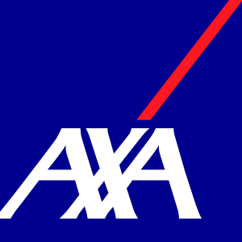





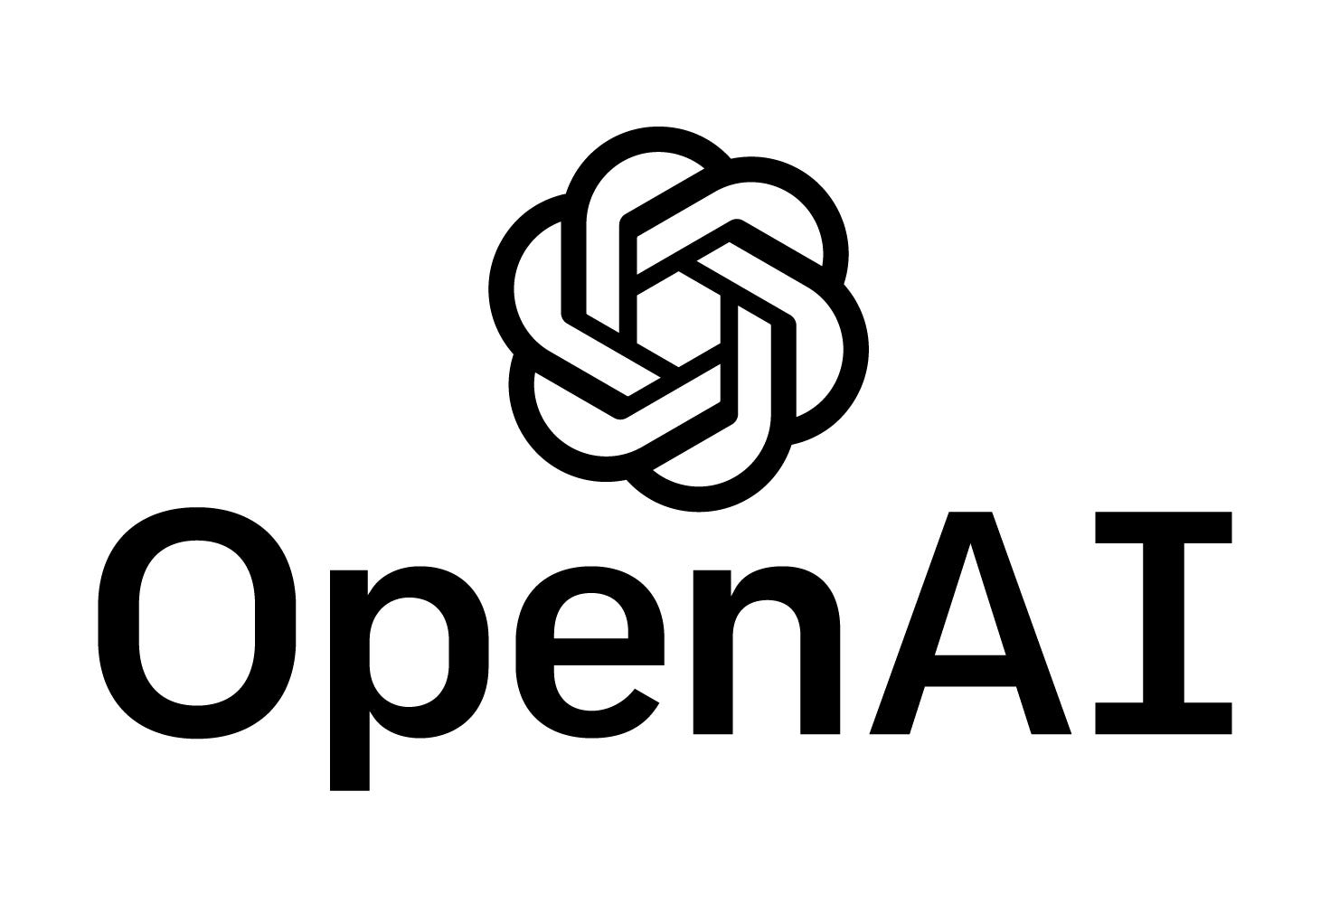

Retrieval Augmented Generation
3x Expert Data Scientist (12 months)
FAISS GPT LangChain LLM (Large Language Model) Mistral AI MongoDB Whisper

